Slide 1
Kernel Principal Component Analysis and Support Vector Machines for Stock Price Prediction
Huseyin Ince, Faculty of Business Administration
Theodore B. Trafalis, School of Industrial Engineering
Presenter: Tsung-Jung Tsai (蔡宗容)
Date: Sept. 3, 2008

Slide 2
Abstract (1/2)
Financial time series are complex, non stationary and deterministically chaotic. Technical indicators are used with Principal Component Analysis (PCA) in order to identify the most influential inputs in the context of the forecasting model. Neural networks (NN) and support vector regression (SVR) are used with different inputs.

Slide 3
Abstract (2/2)
Our assumption is that the future value of a stock price depends on the financial indicators although there is no parametric model to explain this relationship. This relationship comes from the technical analysis. Comparison shows that SVR and MLP networks require different inputs. Besides that the MLP networks outperform the SVR technique.

Slide 4
Stock market
Prediction of financial time series is one of the most challenging applications.
Since the financial market is a complex, non stationary and deterministically chaotic system.
It is very difficult to forecast by using deterministic (parametric) techniques because of the assumptions behind the parametric techniques.

Slide 5
Architecture
Input Features
Input Selection Algorithms
SVR
MLP

Slide 6
Input Selection Algorithms
(1) Kernel Principle Component Analysis
(2) Factor analysis
(3) Heuristic model 1 (H1)
(4) Heuristic model 2 (H2)

Slide 7
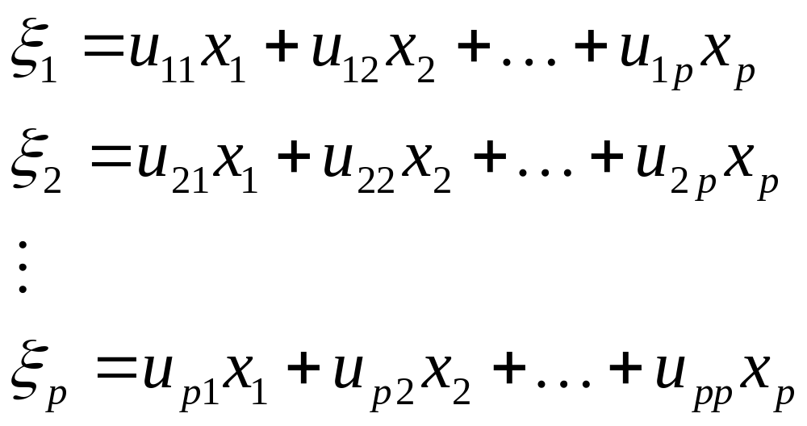
PCA

Slide 8
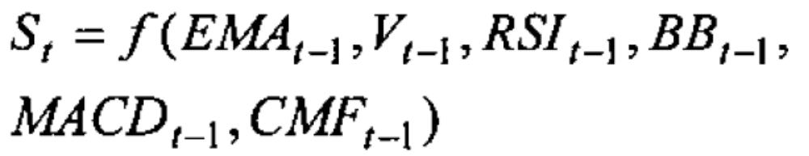
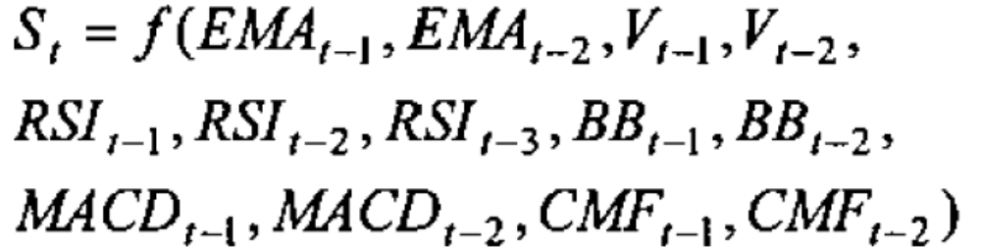
Heuristic model 1 & 2

Slide 9
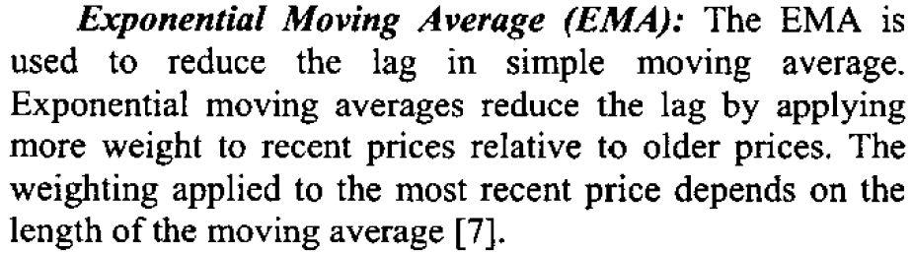
EMA

Slide 10
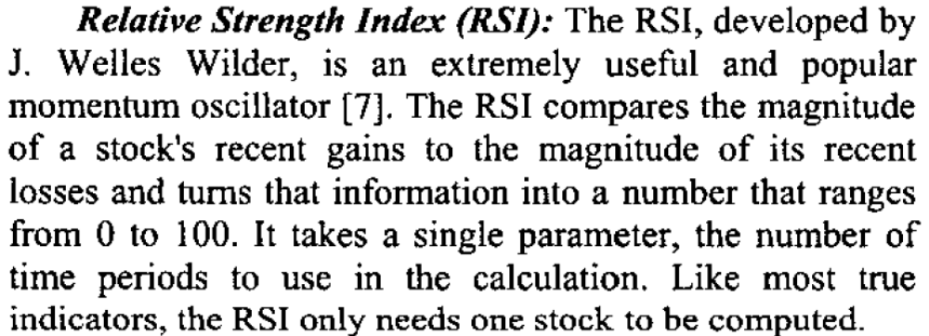
RSI

Slide 11
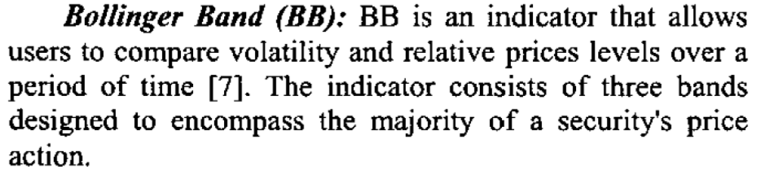
BB

Slide 12
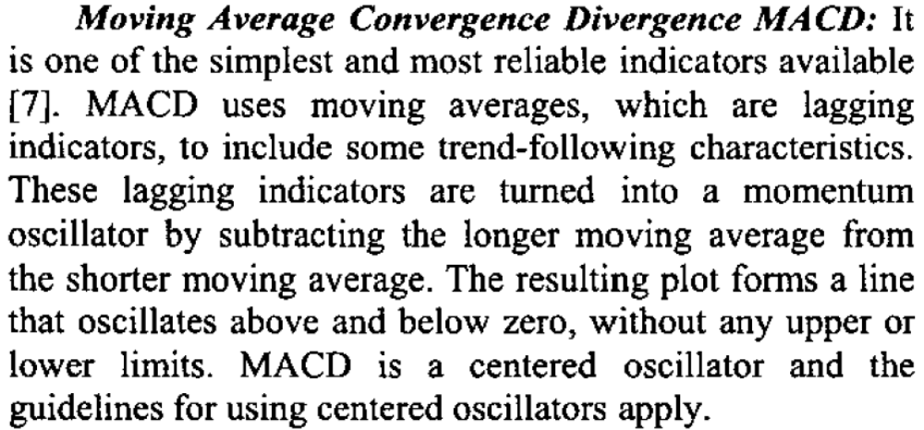
MACD

Slide 13
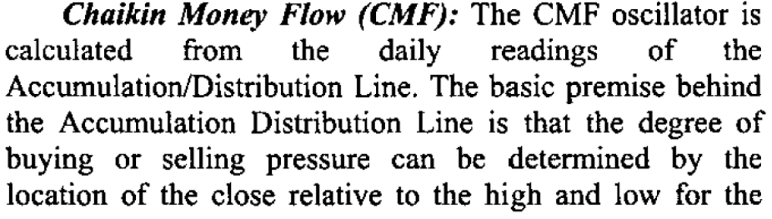
CMF

Slide 14
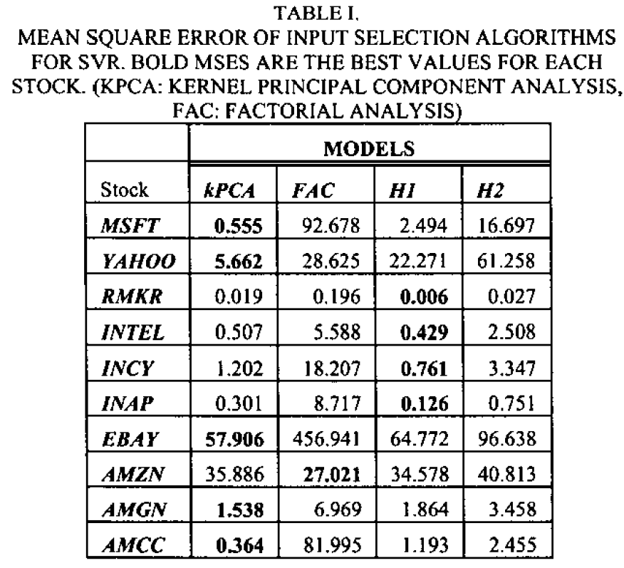

Slide 15
